Slide 1
CHAPTER 6 :
OBJECT-ORIENTED DESIGN

Slide 2
Learning Outcomes
Students able to:
Explain the concept of object-oriented (C2)
Construct design models using object-oriented approach (C3)
Differentiate and show types of models in object-oriented approach (A3, P2)

Slide 3
Topics Covered
An Overview of Object-Oriented Analysis and Design
Introduction to the Unified Modeling Language
Object-Oriented analysis
User Model View : Use Case Model/Use Case Diagram
Object-Oriented design
Object Class Identification
Design Classes & Structural Model View
Behavioural Model View
Design Interface Objects
Implementation Model View
Environmental Model View
Design Rule

Slide 4
An Overview of Object-Oriented Analysis and Design
Object-oriented analysis (OOA) is concerned with developing software engineering requirements and specifications that expressed as a system’s object model
OOA views the world as objects with data structures and behaviors and events that trigger operations, or object behavior changes, that change the state of objects.

Slide 5
An Overview of Object-Oriented Analysis and Design
Use-case model
Design model
Analysis and Design
Architecture
document
Glossary
Supplementary
specification
Data model

Slide 6
An Overview of Object-Oriented Analysis and Design
Analysis versus Design
Analysis :
Focus on understanding the problem
Idealized design
Behavior
System structure
Functional requirements
A small model

Slide 7
An Overview of Object-Oriented Analysis and Design
Analysis versus Design
Design :
Focus on understanding the solution
Operations and attributes
Performance
Close to real code
Object lifecycles
Non-functional requirements
A large model

Slide 8
An Overview of Object-Oriented Analysis and Design
Design is about producing a solution that meets the requirements that have been specified during analysis
The goal → to design the classes that we need to implement the system
Objects discovered during analysis serve as the framework for design
OOD is an iterative process
In OO development, the UML defines the standard modeling artifacts

Slide 9
Introduction to the Unified Modeling Language
Used to derive or
evolve a system
Means to capture
and communicate
a knowledge
about a system
A modeling language
for specifying, visualizing,
constructing, and
documenting
Can be used
through out the
lifecycle of the system
Focuses on
understanding
a subject via
creating a model
Can be used as a
'blueprint' of a
system
It unifies the language
of communication
about a system
Uses visualization

Slide 10
Introduction to the Unified Modeling Language
UML is NOT
a visual programming
language
a tool or repository
specification
a process
UML IS
a visual modeling language
a modeling language
specification
enable processes

Slide 11
Types of UML Diagrams
Each UML diagram is designed to let customers and developers view a software system from a different perspective and in varying degrees of abstraction. UML diagrams include :
User model view= Use-case diagram➔functionality of a system
Structural model view= Class diagram ➔static structure of a system
Behavioral model view =
Sequence diagram ➔ interaction among elements of a system in a time sequence
Collaboration diagram ➔ interaction among elements and their relations organised in time and space
State diagram➔the status condition and responses of the elements of a system
Activity diagram➔the activities of the system

Slide 12
Types of UML Diagrams
Implementation model view= Component diagram ➔the organization of the elements realizing the system
Environment model view= Deployment diagram ➔ configuration of environment elements and the mapping of elements realizing the system into them
Other views can be defined as needed

Slide 13
Object-Oriented Analysis
OOA process :-
1. Identify the actors
2. Develop a simple business process model using UML activity diagram
3. Develop the use-cases
4. Prepare interaction diagrams
5. Classification –develop a static UML class diagram
6. Iterate and refine

Slide 14
User Model View
Use Case Model / Use Case Diagram

Slide 15
Concepts in Use-Case Modeling
A Use-Case model is representation of the system’s intended functions(use-cases) and its environment(actors)
Major concepts in use-case modeling :
Actor
Use-case

Slide 16
Concepts in Use-Case Modeling
An actor represents anything that interacts with the system
A use-case is a sequence of actions a system performs that yields an observable result of value to a particular actor
Primary purpose → is to communicate the system’s functionality and behavior to the customer /end user

Slide 17
UML notation
UML notation for an actor and a use case

Slide 18
Identify Actors
Actors are not part of the system, they represent roles a user of the system can play
User may play more than one role
May actively interchange information with the system
May be a passive recipient of information
Can represent a human, machine, or another system

Slide 19
Identify Actors
Difference between users and actors :
Can play
the role of
USER
ACTOR
performs
USE-CASE
Sufri
member
Borrow book
Yati
employee
Order books
Mila
volunteer
Check IDs

Slide 20
Identify Actors
Who is interested in a certain requirement?
Where in the organization is the system used?
Who will supply the system with this information, use this information, remove this information
Who will use this function?
Who will support and maintain the system?
Does the system use an external resource?
What actors do the use-cases needed?
Does one person play several different roles?
Do several people play the same role?

Slide 21
Description of an Actor
Text
Name
Brief description
Relationships with use cases
Example
Student
A person who signs up for a course
Student
Register for Courses

Slide 22
Identify Use-Cases
A use-case represent a dialogue between actors and the system
Is initiated by an actor to invoke a certain functionality in the system
Is a complete and meaningful flow of events
Student
Register for Courses

Slide 23
Identify Use-Cases
For each actor, find the tasks and functions that the actor should be able to perform OR that the system needs the actor to perform.
The use case should represent a course of event that leads to a clear goal
Name the use-cases
Describe the use-cases briefly by applying terms which the user is familiar

Slide 24
Description of a Use-Case
Text description of a use case
Name
Brief description
Relationships with actors
Example
Register for courses
This use case is initiated by a student. It provides the capability for the student to create, delete, modify and/or review a course schedule for a given semester

Slide 25
Association relationships
Exist between an actor and a use case, and between use cases
A line drawn from an actor to a use case represent an association
At times a use-case includes the functionality, extends the functionality, or generalizes the functionality of another use-case on the diagram
This is shown using include(uses) , extend, and generalization relationships

Slide 26
Association relationships
In the UML, an association relationship is represented by a solid line with or without an arrow
The most general relationship and indicate communication only

Slide 27
Association relationships
<<extend>>
<<include>>
communicate
generalization

Slide 28
Extend relationship
Extend relationship is an association between two use cases where one adds new behaviors or actions to the other.
Extends a use case by adding new behavior or actions.
Specialized use case extends the general use case.

Slide 29
Include relationship
Include relationship is an association between two use cases where one use case uses the functionality contained in the other.
Indicates a use case that is used (invoked) by another use case.
Links to general purpose functions, used by many other use cases.

Slide 30
Generalization association
Represents a specialized use-case to a more generalized one
More general use-case being higher than the lower use-cases
A relationship from child to a parent use case
Arrow is drawn from the specialized use-case to the general (base) use-case
parent
Child 1
Child 2

Slide 31
Benefits of a use-case model
To communicate with the end users and domain experts
To identify :
Who will interact with the system and what the system should do
What interfaces the system should have
To verify :
All requirements are captured
That developers have understood the requirements

Slide 32
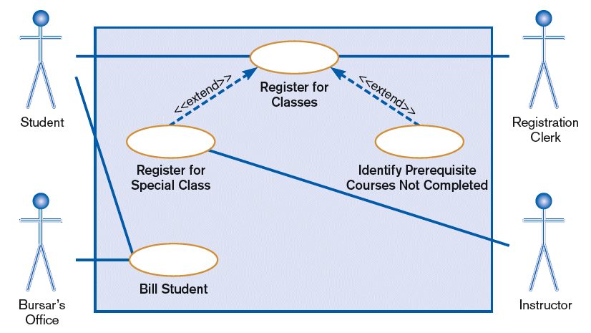
Example:Use Case Diagram
A use case diagram for a university registration system

Slide 33
Use Case Flow of Events
Each use case has to be described in a flow of events document
Is a textual document defines what the system has to do when actor activates a use case (part of the use case specification)
The structure of a use case document can vary

Slide 34
Use Case Flow of Events
Each use case :
Has one normal, basic, sequence of transactions
May have several alternative sequences of transactions
Usually has several exceptional sequences of transactions handling erroneous situations
May also have well defined pre-post conditions

Slide 35
Use Case Flow of Events
Describe only the events that belong to the use case, and not what happens in other use cases
Should include :
How and when the use case starts and ends
When the use case interacts with the actors
What information is exchanged between an actor and the use case
Basic flow of events
Any alternate flow of events

Slide 36
In-Class Exercise: Draw a Use-Case Diagram for the following Library System
The library stores various items that can be borrowed, including books and journals. Both staff and students can borrow books, but only staff members can borrow journals. When a user borrows a book, their loan details are checked to ensure that they have no overdue books on loan, and have not already borrowed the maximum permitted number of books. Users can check their own loan details at any time. Librarians are permitted to check the loan details of any user. Users also can reserve books that are currently out on loan.
Question:
identify actors;
identify use-cases;
draw a use-case diagram for the above description

Slide 37
Homework: Draw a use case diagram to illustrate the following use cases and the relationships between them
Use case: Pay by credit card
Actor(s): Customer, NetPay
Usual Flow:
The system requests credit card information from the customer to pay for their order
The customer gives their credit card information
The system send their credit card details to NetPay for processing
Use case: Place an order on the web site
Actor(s): Customer, Order Processing, NetPay
Usual Flow:
The customer chooses to create a new order
The customer selects order items from the product catalogue and specifies the amount required
The customer asks to preview their order.
The system displays the list of order items and the total order price including VAT
The customer confirms their order (rather than cancelling it)
The system requests credit card information from the customer to pay for their order
The customer gives their credit card information
The system send their credit card details to NetPay for processing
If payment is accepted, the system forwards the order to order processing and displays an order confirmation that has a unique reference so both order processing and the customer know which order they are referring to during any enquiries
Use case: Place an order by phone
Actor(s): Customer, Sales Clerk, Order Processing, NetPay
Usual Flow:
The customer calls the sales hotline and selects the “place an order” option
The customer selects the “add item” option
The system requests the product catalogue number and quantity for the order item
The customer enters the product catalogue number and quantity
The customer asks to preview their order
The system reads back their order giving the total price plus VAT
The customer confirms their order (rather than cancelling it)
The customer pays by credit card through NetPay
If their payment is accepted the system reads out an order confirmation reference
The customer hangs up the phone

Slide 38
Object-Oriented Design
There are a variety of different object-oriented design processes that depend on the organization using the process.
Common activities in these processes include:
Define the context and modes of use of the system (covered in Chp 3);
Design the system architecture (covered in Chp 4);
Identify the principal system objects;
Develop design models;
Specify object interfaces.

Slide 39
OBJECT CLASS IDENTIFICATION
Identifying object classes is often a difficult part of object oriented design.
There is no 'magic formula' for object identification. It relies on the skill, experience and domain knowledge of system designers.
Object identification is an iterative process. You are unlikely to get it right first time.

Slide 40
What Is an Object?
An entity that encapsulates data and behavior
Examples: product, employee, order, line item
Class – a set of objects that share the same attributes, operations, relationships, and semantics (abstract)
Instance – a single object (concrete)

Slide 41
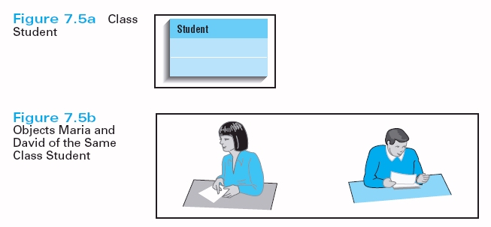
What Is an Object?

Slide 42
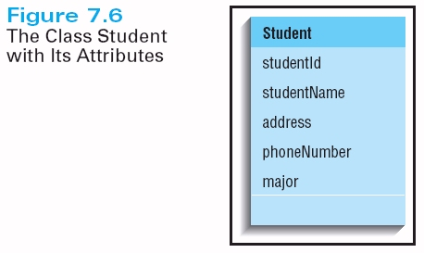
What Is an Object?

Slide 43
What Is an Attribute?
A named property of a class that describes a range of values that instances of the attribute may hold
Types of Attributes
Simple attributes – contain single data item
Identifiers – connect unique key value
Multivalued attributes – contain multiple values simultaneously
Composite attributes – group of related attributes

Slide 44
What Is an Operation?
Operation implements the behavior of classes
It represent the process or service that can be requested.
In general, the data-driven OOAD methods place less emphasis on defining operations early in the modeling process than do the behavior-driven methods

Slide 45
Approaches to object class identification
Use a grammatical approach based on a natural language description of the system (used in Hood OOD method).
Base the identification on tangible things in the application domain.
Use a CRC approach based on identifying classes and their responsibilities and collaborators.
Use a behavioural approach and identify objects based on what participates in what behaviour.
Use a scenario-based analysis. The objects, attributes and methods in each scenario are identified.

Slide 46
Example: Weather station description
A weather station is a package of software controlled instruments which collects data, performs some data processing and transmits this data for further processing. The instruments include air and ground thermometers, an anemometer, a wind vane, a barometer and a rain gauge. Data is collected periodically.
When a command is issued to transmit the weather data, the weather station processes and summarises the collected data. The summarised data is transmitted to the mapping computer when a request is received.

Slide 47
Weather station object classes
Object class identification in the weather station system may be based on the tangible hardware and data in the system:
Ground thermometer, Anemometer, Barometer
Application domain objects that are ‘hardware’ objects related to the instruments in the system.
Weather station
The basic interface of the weather station to its environment. It therefore reflects the interactions identified in the use-case model.
Weather data
Encapsulates the summarized data from the instruments.

Slide 48
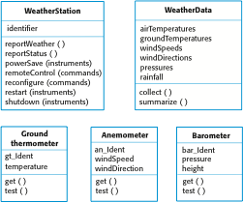
Weather station object classes

Slide 49
Classes, Responsibilities, and Collaborators (CRC)
Developed by Cunningham, Wilkerson and Beck
Can be used for identifying classes and their responsibilities.
Based on the idea that an object either can accomplish a certain responsibility itself or it may require the assistance of other objects

Slide 50
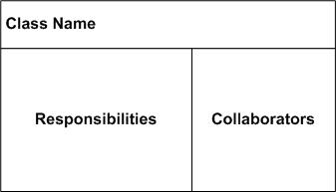
CRC Card
CRC cards are 4" x 6" index cards. All the information for an object is written on a card.

Slide 51
CRC Approach
A responsibility is anything that a class knows or does.
For example, students have names, addresses, and phone numbers. These are the things a student knows.
Students also enroll in seminars, drop seminars, and request transcripts. These are the things a student does.
The things a class knows and does constitute its responsibilities.
Important: A class is able to change the values of the things it knows, but it is unable to change the values of what other classes know.

Slide 52
CRC Approach
If it requires an assistance of other objects→ it must collaborate with those objects to fulfill its responsibility
By identifying an object’s responsibilities and collaborators, you can identify its attributes and operations

Slide 53
CRC Approach
Collaboration takes one of two forms: A request for information or a request to do something.
For example, the card Student requests an indication from the card Seminar whether a space is available, a request for information.
Student then requests to be added to the Seminar, a request to do something.
Another way to perform this logic, however, would have been to have Student simply request Seminar to enroll himself into itself.
Then have Seminar do the work of determining if a seat is available and, if so, then enrolling the student and, if not, then informing the student that he was not enrolled.

Slide 54
CRC Approach
The CRC process :
Identify classes
& responsibility
iterate
Identify
collaboration
Assign
responsibility

Slide 55
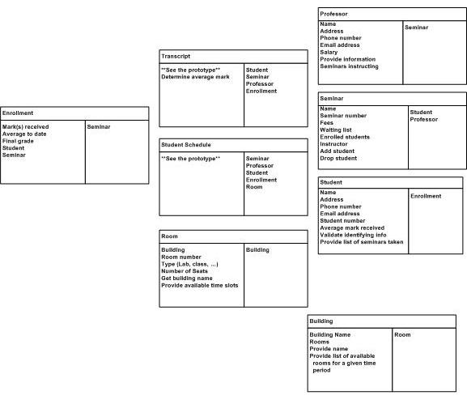
Example: CRC Model

Slide 56
DESIGN CLASSES & STRUCTURAL MODEL VIEW
Design classes
Class diagram

Slide 57
DESIGN CLASSES
Most important activity in designing an application → coming up with a set of classes that work together to provide the needed functionality
Underlying the functionality of any application is the → quality of its design

Slide 58
Designing Classes : the process
1.apply design axioms to design classes, their attributes, methods, associations, structures, & protocols
1.1 Refine and complete the static UML class diagram by adding details to that diagram
Refine attributes
Design methods and the protocols by utilizing a UML activity diagram to represent the method’s algorithm
Refine the associations between classes (if required)
Refine the class hierarchy and design with inheritance (if required)
1.2 Iterate and refine

Slide 59
Class Visibility : Public, Protected, Private Protocols
In designing methods or attributes for classes, there are two things that need to be considered :
The protocol (or interface) to the class operations and its visibility
How it is implemented
Visibility is used to enforce encapsulation → may be public, protected, or private

Slide 60
Class Visibility : Public, Protected, Private Protocols
Public
protocols
Private
protocols
Protected
protocols

Slide 61
Class Visibility : Public, Protected, Private Protocols
Private protocols of the class, includes messages that normally should not be sent from other objects
It is accessible only to operations of that class
Only the class itself can use the method

Slide 62
Class Visibility : Public, Protected, Private Protocols
Public protocol defines the stated behavior of the class as a citizen in a population and is important information for users as well as future descendants
It is accessible to all classes
Protected protocol
Methods or attributes can be used by the class itself or its subclasses

Slide 63
Class Visibility : Public, Protected, Private Protocols
In UML, the following symbol are used to specify export control :
+ public
# protected
- private

Slide 64
Designing Classes : Refining Attributes
Attributes provide information storage for the class instance and are often used to represent the state of the class instance
Any information the class itself maintains is done through its attributes
In design phase→ detailed information must be added to the model that defines the class attributes & operations

Slide 65
Designing Classes : Refining Attributes
May need to add additional attributes to support the implementation and establish any new relationship that the attributes require
Attribute presentation suggested by UML :
Visibility name : type-expression = initial value or default

Slide 66
Designing Classes : Refining Attributes
Visibility name:type-expression = initial value or default
Is a language-dependent
specification of the
implementation type of an attribute
+ public : accessibility to all classes
# protected : accessibility to subclasses
And operations of the class
- private : accessibility only to operations of the class
Is a language-dependent
Expression for the initial value of newly created object (initial value is optional)

Slide 67
Design Methods and Protocols
A method specifies the implementation of an operation
It describes HOW the operation works, not just WHAT it does
Operations should be named to indicate their outcome [ex : getBalance() ]
Operation visibility :
+ public, # protected, - private

Slide 68
Design Methods and Protocols
UML Operation presentation
Visibility name: (parameter-list): return-type-expression
A list of parameters, separated by commas, each specified by name: type-expression = default value
+public
#protected
-public
Is a language-dependent specification of the implementation of the value returned by the method, Ex: +getAccountNo.(account: type) : accountNo.
Name of the operation

Slide 69
Design Methods and Protocols
Example:
Student
StudentId Name Address
+getStudentId(): int +getName(): string +getAddress(): string

Slide 70
Design Methods and Protocols
The method should discuss:
How operation are to be implemented
How attributes are to implemented and used to implement operations
How relationship are to be implemented and used to implement operations
What other objects & operations are to used
How parameters are to be implemented
Any special algorithms to be used

Slide 71
Design Methods and Protocols
A class can provide several types of methods:
Constructor – method that creates instances (objects) of the class
Destructor – method that destroys instances
Conversion method – method that converts a value from one unit of measure to another
Copy method – method that copies the contents of one instance to another instance

Slide 72
Design Methods and Protocols
Attribute set – method that sets the vales of one or more attributes
Attribute get – method that returns the value of one or more attributes
I/O methods - method that provide or receive data to or from a device
Domain specific – method specific to the application

Slide 73
Class Diagram
A class diagram shows a set of classes, interfaces, and collaborations and their relationships
Model the static view of the system, which supports the functional requirements
Made up of the following basic elements
Classes
Relationships(associations, aggregations, generalization, dependency )

Slide 74
Class Diagram
Example :
<<boundary>>
ScheduleForm
<<entity>>
Course
0..4
1
1
Adds student to
1
1
1
<<entity>>
CourseCatalog
<<control>>
RegistrationController
1
1
<<entity>>
StudentRecord
accesses

Slide 75
In-Class Exercise
Draw a class diagram to represent the following:
A customer has a first name, a last name, middle names, a daytime telephone number and a home address. A customer can place orders, and a record of all orders is kept. An order has a billing address and a shipping address, which can be the same address – by default the customer’s home address is used for both. An order has one or more order items. Each order item is for specific product. Each order item records the quantity of each product ordered, and the subtotal for that item (quantity * unit price). An order also calculates the total amount payable + 17.5% VAT. An order can be either unconfirmed, confirmed, shipped or received. A confirmed order has a unique reference, which is a unique integer (eg, last reference + 1). A record of the order confirmation date is kept, as well as the shipped date and the date the order was received.

Slide 76
BEHAVIORAL MODEL VIEW
Sequence diagram
Collaboration diagram
State diagram
Activity diagram

Slide 77
Interaction Diagrams
A graphical representation of interactions between objects
Two kinds of interaction diagrams
Sequence diagrams – time oriented
Collaboration diagrams – message oriented

Slide 78
Sequence Diagram
Shows object interactions arranged in time sequence
The diagram shows
The objects participating in the interaction
The sequence of messages exchanged

Slide 79
Sequence Diagram
Basic elements :
Actors – someone/something outside the system that interacts with the system
Objects – an entity with a well-defined boundary and identity that encapsulates state and behavior
Object representation in UML :
Math102
Math102:
CourseOffering
:CourseOffering
Object name
Object name and
Class name
Class name

Slide 80
Sequence Diagram
Basic elements :
Messages – communication between two objects that triggers an event
Lifelines – represents the existence of the object at a particular time
: Student
:registration
form
message
1: fill in info
2: submit
lifelines

Slide 81
Sequence Diagram
Basic elements :
Focus of control (optional) – shows the period of time during which an object is performing an action, either directly or through a subordinate procedure
: Student
:registration
form
1: fill in info
Focus of
control
2: submit

Slide 82
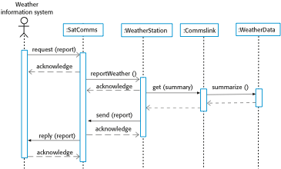
Example: Sequence diagram describing data collection

Slide 83
Drawing Sequence Diagrams
Determine the context of the sequence diagram
Identify the object that are participate in the sequence
Set of the lifeline for each object
Lay out of messages from the top to the bottom of the diagram based on the order in which they sent
Add the execution occurrence to each object’s lifeline
Validate the sequence diagram

Slide 84
Use Case: ATM
ATM System
ATM approval
Deposit amount
Client
Withdraw amount

Slide 85
Use Case: ATM approval
Flow-of-event:
Insert ATM card
Request PIN
Enter PIN
Verify PIN
Display message to client

Slide 86
Client
ATM Machine
AccountDatabase
read card()
Request PIN()
Enter PIN()
Verify PIN()
Return verification()
Use case: ATM approval
Insert ATM card
Request PIN
Enter PIN
Verify PIN
Display message to client
Display message()

Slide 87
Use Case: Withdraw saving
A customer wants to draw money from his bank account. He enters his card into an ATM (automated teller machine). The ATM machine prompts “ Enter PIN”. The customer enters his PIN. The ATM (internally) retrieves the bank account number from the card. The ATM encrypts the PIN and the account number and sends it over to the bank. The bank verifies the encrypted account and PIN number. If the PIN number is correct, the ATM displays, “Enter Amount”. Draws money from the bank account and pays out the amount.

Slide 88
Use Case: Withdraw saving
Use Case: Withdraw Saving
Actors: Bank Client
Flow of Events:
Bank client insert ATM card into ATM machine
ATM machine request PIN code
Bank client enter PIN code
Verify PIN code entered with saving account
ATM machine request amount if the PIN is valid
Bank client enter the required amount
Process the transaction in the client account
ATM machine dispense cash
ATM machine print receipt when the transaction completed
Alternative Flow of Events
Invalid PIN code entered. Indicate error message. Return step 3.

Slide 89
Identifying Classes – noun phrase approach (example)
ATM System
Bank Client
ATM Card
ATM Machine
Savings Account
Cash
Message

Slide 90
Client
ATMMachine
SavingAccount
readATM card()
Request PIN()
Enter PIN()
Verify PIN()
Verification()
Request amount()
Enter amount()
Process transaction()
Transaction successful()
Dispense cash()
Print receipt()

Slide 91
Collaboration Diagram
Alternate way to represent the messages exchanged by a set of objects
Shows object interactions organized around the objects and their links to each other
Basic elements : actors, objects, messages, links (pathway for communication between objects )

Slide 92
Collaboration Diagram
1: insert ATM card
3: enter PIN code
7: enter amount
:ATMMachine
:Client
2: request PIN
6: request amount
10: dispense cash
11: print receipt
4: verify PIN code
8: process transaction
5: valid PIN code
9: transaction successful
:SavingAccount

Slide 93
In-Class Exercise
Draw a sequence diagram that shows Andy (Madeup-Name) interacting with objects in the system that achieves the same effect that follows this flow: 1. Andy creates a new order item 2. Andy selects the product Snow Flake Templates from the product catalogue 3. Andy specifies the order item quantity 5 4. Andy adds the item to the order
(Hint:your sequence diagram should conform to the class model in previous exercise)

Slide 94
Design Classes – Define State
The state an object resides, in is a computational state, and is define by the stimuli the object can receive and what operations can be performed as a result
Design how an object’s state affects its behavior
Develop statecharts(state diagram) to model this behavior

Slide 95
Design Classes – Define State
A statechart is a diagram used to show the life history of a given class, the events that cause a transition from one state to another, and the actions that result from a state change.
State diagrams are useful high-level models of a system or an object’s run-time behavior.
You don’t usually need a state diagram for all of the objects in the system. Many of the objects in a system are relatively simple and a state model adds unnecessary detail to the design.

Slide 96
Design Classes – Define State
State name
stateVar: type = value
Event(arguments)[guard condiiton]
/operation(arguments)^target.sendEvent(arguments)
Entry/entry action
Do/activity
Exit/exit action

Slide 97
Design Classes – Define State
Initial state
Final state
Statechart is to model a specific class (not all class need to have a statechart diagram)

Slide 98
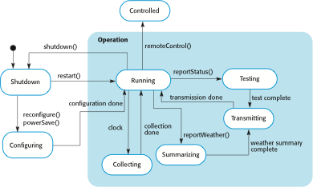
Example: Weather station state diagram

Slide 99
In-Class Exercise: DigitalPet
Identify the states and transitions of the digital pet and draw a state diagram.
You’re creating a digital pet program. What happens to the pet when he receives different stimuli is determined by the state he’s in, so you decide to model the digital pet with a state diagram. The behavior of the digital pet program is as follows:
When the pet is turned on, it starts out happy
If the pet is happy and receives punishment, then he becomes sad
If the pet is sad and receives praise, it becomes happy
If the pet is sad and receives punishment, it is heart-broken
[Copyright: Russ Miles]

Slide 100
Activity Diagram
Show the conditional logic for the sequence of system activities needed to accomplish a business process.
Clearly show parallel and alternative behaviors.
Can be used to show the logic of a use case.
Use Activity Diagram to:
Depict the flow of control from activity to activity.
Help in use case analysis to understand what actions need to take place.
Help in identifying extensions in a use case.
Model work flow and business processes.
Model the sequential and concurrent steps in a computation process.

Slide 101
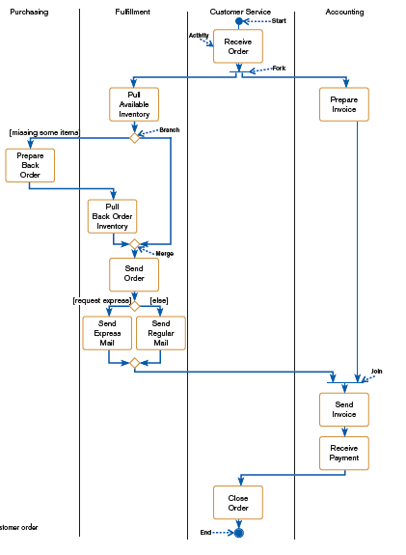
Activity Diagram
Activity diagram for a customer order
process

Slide 102
Activity Diagram
Elements of Activity Diagram:
Activity: a behavior that an object carries out while in a particular state
Transition: a movement from one activity or state to another
Branch: a diamond symbol containing a condition whose results provide transitions to different paths of activities
Synchronization bar: horizontal or vertical bars denoting parallel or concurrent paths of activities
Fork: the beginning of parallel activities
Join: the end of parallel activities
Swimlanes: columns representing different organizational units of the system

Slide 103
In-Class Exercise:
Booking a Room in a hotel. Model processes with activity diagram
When customer requests a room, the hotel employee looks for room availability, then he insert customer’s data and verifies if the provided credit card number has enough credit to pay the room: in this case the booking is confirmed and we wait customer arrival.
The Hotel information system allows customer to modify or cancel his/her reservation. If customer arrives he uses the room and then he pays, in case of no-show a penalty is accounted on his credit card and the booking is canceled.

Slide 104
DESIGN INTERFACE OBJECTS

Slide 105
Interface specification
Object interfaces have to be specified so that the objects and other components can be designed in parallel.
Designers should avoid designing the data representation but should hide this in the object itself.
Objects may have several interfaces which are viewpoints on the methods provided.
The UML uses class diagrams for interface specification but Java may also be used.

Slide 106

Example: Weather station interfaces

Slide 107
IMPLEMENTATION MODEL VIEW-Component Diagram &
ENVIRONMENTAL MODEL VIEW-Deployment Diagram

Slide 108
Component diagram
Dependencies among components are shown, including source code components, binary code components, and executable components
Register.exe
People.dll
Course.dll
StudentInfo
ProfessorInfo
Course
CourseOffering

Slide 109
Deployment diagram
Displays the configuration of run-time processing elements and the software components, processes, and objects that live on them
Registration
Database
Library
Main
Building
Dorm

Slide 110
DESIGN RULES
1. Uncoupled design with less information content
2. Single purpose
3. Large number of simple classes
4. Strong mapping
5. Standardization
6. Design with inheritance

Slide 111
Design Rules
1. Uncoupled design with less information content
Highly cohesive objects can improve coupling because only a minimal amount of essential information need be passed between objects
Cohesion = interaction within a single object
Coupling = interaction between objects
High cohesion and Low coupling are desirable

Slide 112
Design Rules
2. Single purpose
Each class must have a purpose and clearly defined
Each method must provide only one service

Slide 113
Design Rules
3. Large number of simple classes
Keeping the classes simple allows reusability
A class that easily can be understood and reused (or inherited) contributes to the overall system
Complex and poorly designed class usually cannot be reused

Slide 114
Design Rules
4. Strong mapping
There must be a strong association between analysis’s object and design’s object
OOA and OOD are based on the same model
As the model progresses from analysis to implementation, more detailed is added

Slide 115
Design Rules
5. Standardization
Promote standardization by designing interchangeable components and reusing existing classes or components
The concept of design patterns might provide a way to capture the design knowledge, document it, and store it in a repository that can be shared and reused in different applications

Slide 116
Design Rules
6. Design with inheritance
Common behavior (methods) must be moved to superclasses
The superclass-subclass structure must make logical sense

Slide 117
Key points
Software design and implementation are inter-leaved activities. The level of detail in the design depends on the type of system and whether you are using a plan-driven or agile approach.
The process of object-oriented design includes activities to design the system architecture, identify objects in the system, describe the design using different object models and document the component interfaces.
A range of different models may be produced during an object-oriented design process. These include static models (class models, generalization models, association models) and dynamic models (sequence models, state machine models).
Component interfaces must be defined precisely so that other objects can use them. A UML interface stereotype may be used to define interfaces.

Slide 118
Key points
Classes identified during analysis provide the framework for the design phase
In design phase, analysis models are refined
Good design should exhibit high cohesion and low coupling
In design phase, need to consider : the class visibility(attributes,operations), class diagram refinement, user interface object, database design and packages
Design is about producing a solution that meets the requirements that have been specified during analysis

Slide 119
Lecture Resources
Credits : Material for the slides is extracted from a variety of sources :
Internet
Books :
Sommerville, I. (2011). Software Engineering,9th edition, Pearson Education Inc.
Ali Bahrami : Object-Oriented Systems Development Using the Unified Modeling Language, Irwin/McGraw-Hill 1999
Simon Bennett, Steve McRobb and Ray Farmer : Object-Oriented Systems Analysis and Design Using UML, Second Edition, McGraw-Hill 2002
Leszek A.Maciaszek : Requirements Analysis and System Design, Developing Inforamtion Systems with UML, Addison_Wesley 2001
Grady Booch, et al: The Unified Modeling Language User Guide, Addison-Wesley 1999

